Slide 1
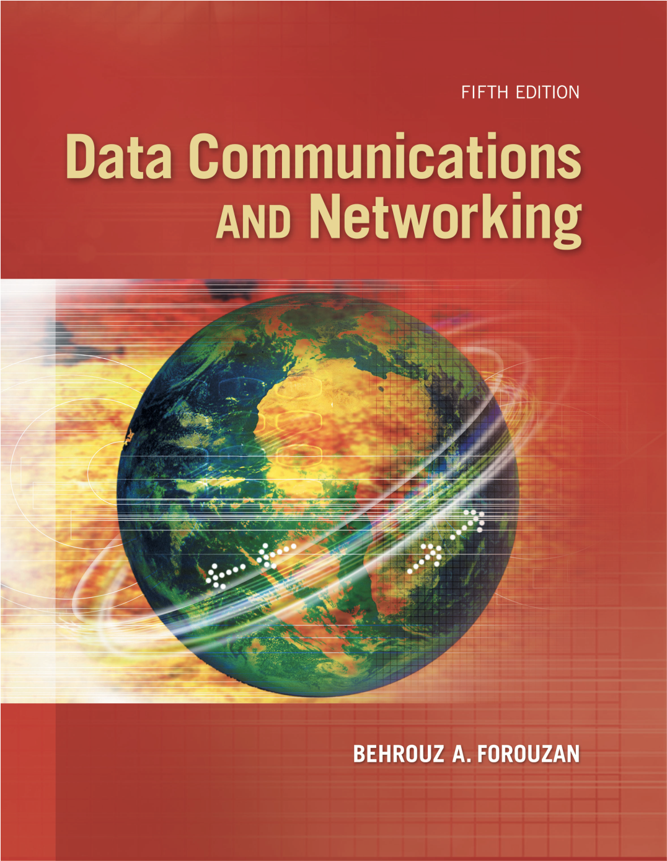
Chapter 8
Switching
Copyright © The McGraw-Hill Companies, Inc. Permission required for reproduction or display.
Notes:
8.#

Slide 2
Chapter 8: Outline
8.1 INTRODUCTION
8.2 CIRCUIT-SWITCHED NETWORK
8.3 PACKET-SWITCHING
8.4 STRUCTURE OF A SWITCH
Notes:
8.#
8.#

Slide 3
    8-1 INTRODUCTION
Network connections rely on switches.
Switches operate at the
  Physical layer
  Data link layer
  Network layer
8.<number>
Notes:
8.#
8.#

Slide 4
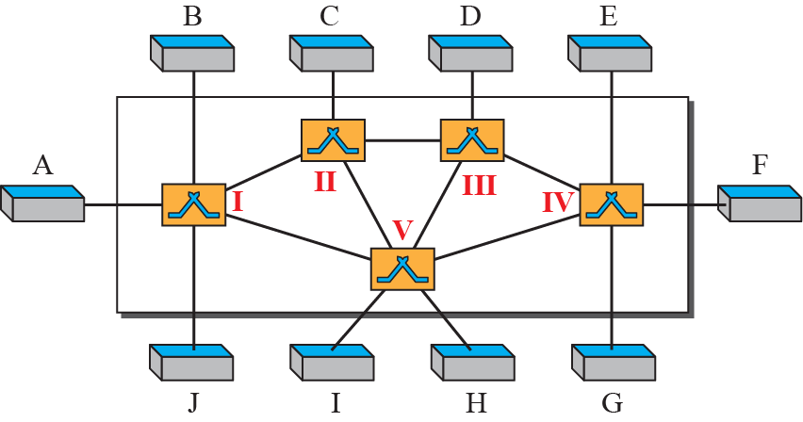
Figure 8.1: Switched network
8.<number>
Notes:
8.#
8.#

Slide 5
8.8.1 Three Methods of Switching
These are the two most common methods of switching:
  circuit switching
  packet switching
8.<number>
Notes:
8.#
8.#

Slide 6
8.8.1 Three Methods of Switching
Packet switching can further be divided into two subcategories,
  virtual-circuit approach and
  datagram approach
8.<number>
Notes:
8.#
8.#

Slide 7
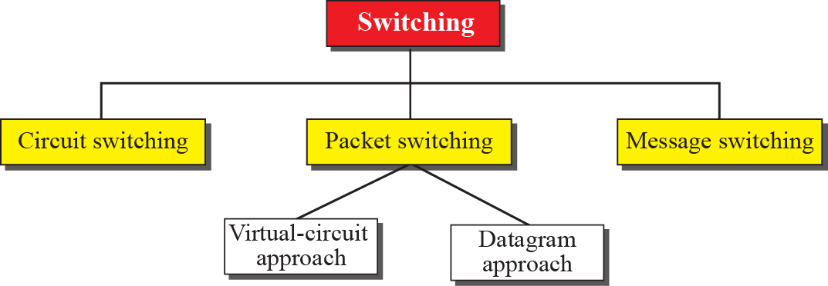
Figure 8.2: Taxonomy of switched networks
8.<number>
Notes:
8.#
8.#

Slide 8
8.8.1 Three Methods of Switching
  Circuit switched network operates at the Physical layer
  Virtual-circuit network operates at the Data-Link layer (or Network layer)
  Datagram network operates at the Network layer
8.<number>
Notes:
8.#
8.#

Slide 9
    8-2 CIRCUIT-SWITCHED NETWORKS
A circuit-switched network consists of a set of switches connected by physical links.
8.<number>
Notes:
8.#
8.#

Slide 10
    8-2 CIRCUIT-SWITCHED NETWORKS
A circuit-switched network consists of a set of switches connected by physical links.
Circuit-switches operate at the physical layer.
A circuit-switched network creates a dedicated path to complete a link between the sender and receiver.
8.<number>
Notes:
8.#
8.#

Slide 11
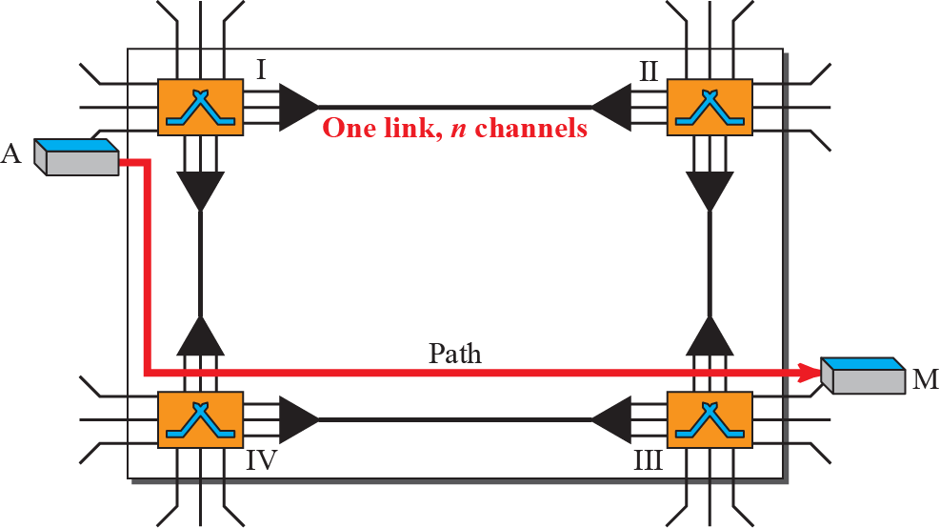
Figure 8.3: A trivial circuit-switched network
8.<number>
Notes:
8.#
8.#

Slide 12
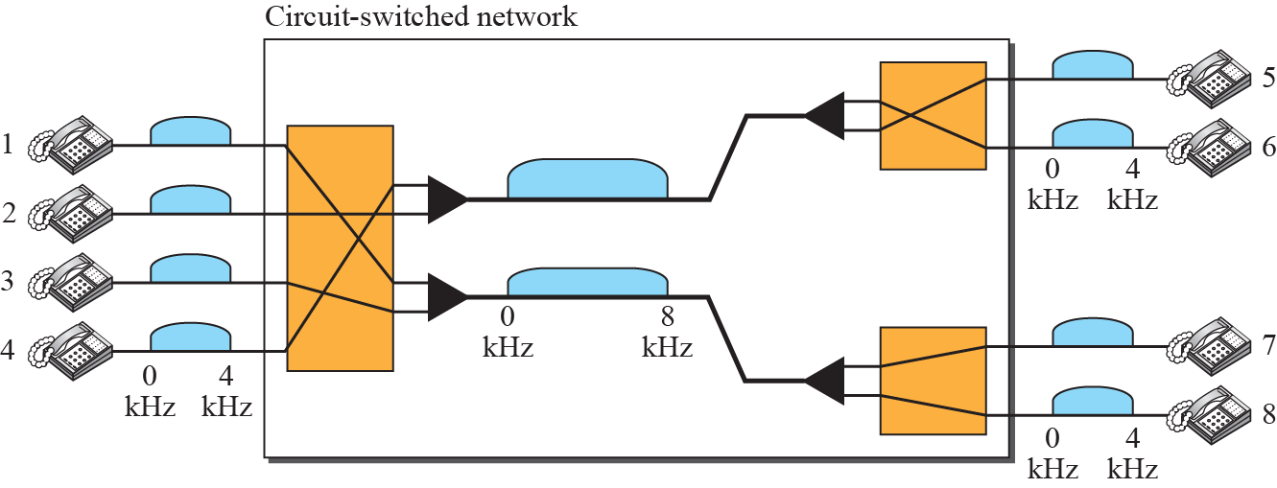
Figure 8.4: Circuit-switched network used in Example 8.1
As a trivial example, let us use a circuit-switched network to connect eight telephones in a small area. Communication is through 4-kHz voice channels. We assume that each link uses FDM to connect a maximum of two voice channels. The bandwidth of each link is then 8 kHz. Figure 8.4 shows the situation. Telephone 1 is connected to telephone 7; 2 to 5; 3 to 8; and 4 to 6.
8.<number>
Notes:
8.#
8.#

Slide 13
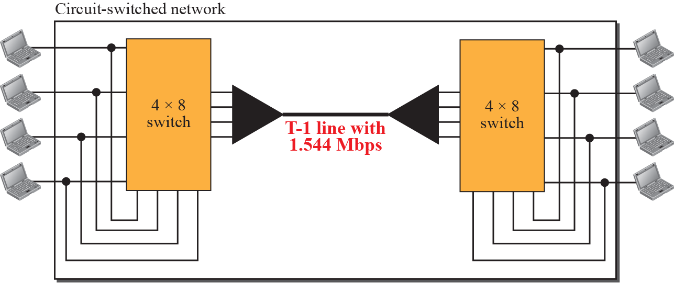
Figure 8.5: Circuit-switched network used in Example 8.2
8.<number>
Notes:
8.#
8.#

Slide 14
8.2.1 Three Phases
The actual communication in a circuit-switched network requires three phases:
  connection setup (handshake),
  data transfer, and
  connection teardown.
8.<number>
Notes:
8.#
8.#

Slide 15
8.2.2 Efficiency
It can be argued that circuit-switched networks are not as efficient as the other two types of networks because resources are allocated during the entire duration of the connection.
8.<number>
Notes:
8.#
8.#

Slide 16
8.2.2 Efficiency
These resources are unavailable to other connections. In a telephone network, people normally terminate the communication when they have finished their conversation.
8.<number>
Notes:
8.#
8.#

Slide 17
8.2.3 Delay
During data transfer the data are not delayed at each switch; the resources are allocated for the duration of the connection.
8.<number>
Notes:
8.#
8.#

Slide 18
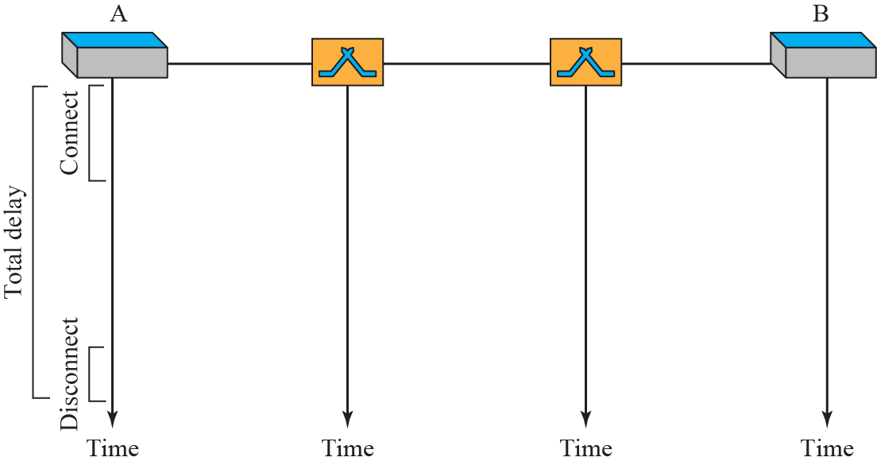
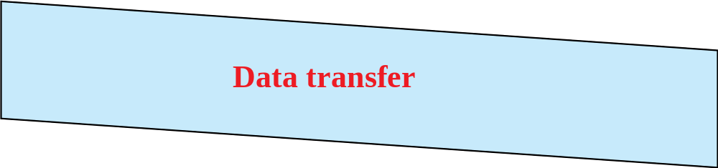
Figure 8.6: Delay in a circuit-switched network
8.<number>
Notes:
8.#
8.#

Slide 19
    8-3 PACKET SWITCHING
A packet-switched network divides the data into packets of fixed or variable size.
The size of the packet is determined by the network and the governing protocol.
8.<number>
Notes:
8.#
8.#

Slide 20
    8-3 PACKET SWITCHING
Packet switched networks are classified as
a) Datagram Networks
b) Virtual circuit Networks
8.<number>
Notes:
8.#
8.#

Slide 21
8.3.1 Datagram Networks
In a datagram network, each packet is treated independently of all others.
Even if a packet is part of a multi-packet transmission, the network treats packets as though they existed alone. Packets in this approach are referred to as datagrams.
8.<number>
Notes:
8.#
8.#

Slide 22
8.3.1 Datagram Networks
In a datagram network, each packet is treated independently of all others. Known as a connectionless network.
A datagram network operates at the Network layer.
8.<number>
Notes:
8.#
8.#

Slide 23
8.3.1 Datagram Networks
Even if a packet is part of a multipacket transmission, the network treats each packet as an independent message.
Each packet of one message can travel a different route towards their final destination.
8.<number>
Notes:
8.#
8.#

Slide 24
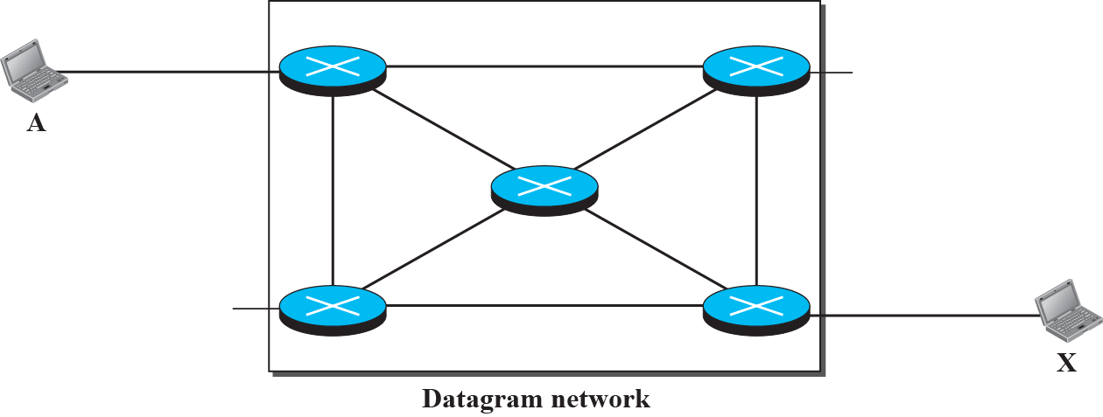






Figure 8.7: A Datagram network with four 3-level switches (routers)
8.<number>
Notes:
8.#
8.#

Slide 25
8.3.1 Datagram Networks (Routing Table)
All packets have a destination address in the header.
8.<number>
Notes:
8.#
8.#

Slide 26
8.3.1 Datagram Networks (Routing Table)
The packets have a destination address in the header.
The destination address for each datagram is used at a router to forward the message towards its final destination.
8.<number>
Notes:
8.#
8.#

Slide 27
8.3.1 Datagram Networks (Routing Table)
The packets have a destination address in the header.
A circuit switched network does not require a header or destination address for the data transfer stage, the link is dedicated!
8.<number>
Notes:
8.#
8.#

Slide 28
8.3.1 Datagram Networks (Routing Table)
The packets have a destination address in the header.
The packet header contains a sequence number in the header so it can be ordered at the destination.
8.<number>
Notes:
8.#
8.#

Slide 29
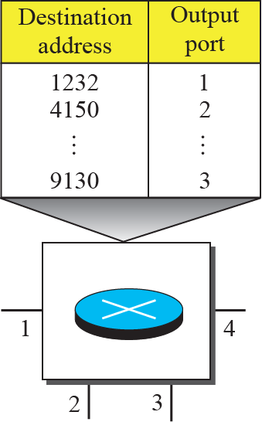
Figure 8.8: Routing table in a datagram network
8.<number>
Notes:
8.#
8.#

Slide 30
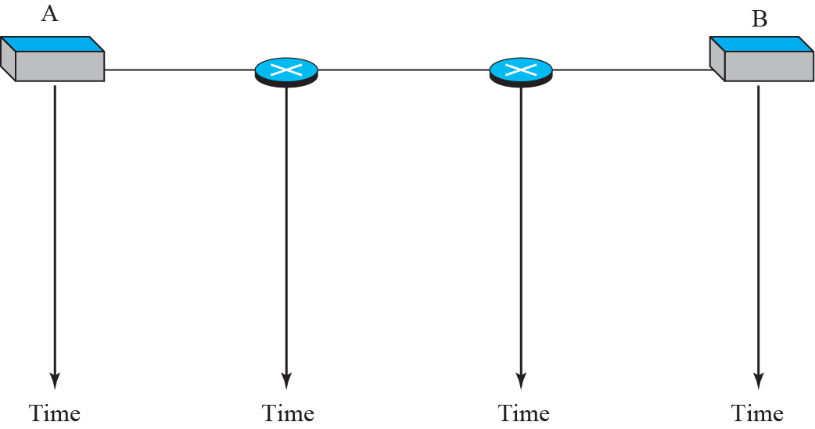




Figure 8.9: Delays in a datagram network (compare to next slide)
8.<number>
Notes:
8.#
8.#

Slide 31
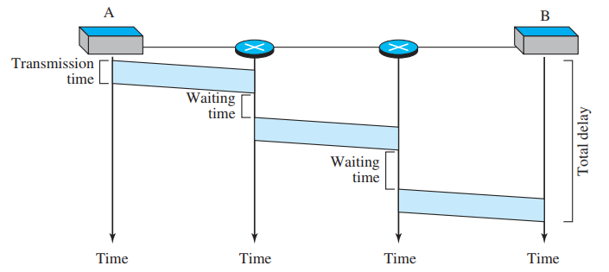
Figure 8.9: Delays in a datagram network (compare to next slide)
8.<number>
Notes:
8.#
8.#

Slide 32
Figure 8.6: Compare the datagram network to the circuit-switched network
8.<number>
Notes:
8.#
8.#

Slide 33
8.3.2 Virtual-Circuit Networks
A virtual-circuit network is a cross between a circuit-switched network and a datagram network.
The virtual-circuit shares characteristics of both.
8.<number>
Notes:
8.#
8.#

Slide 34
8.3.2 Virtual-Circuit Networks
A virtual-circuit network is a cross between a circuit-switched network and a datagram network.
The virtual-circuit network operates at the data-link layer (or network layer).
8.<number>
Notes:
8.#
8.#

Slide 35
8.3.2 Virtual-Circuit Networks
A virtual-circuit network is a cross between a circuit-switched network and a datagram network.
The packets for a virtual circuit network are known as frames.
8.<number>
Notes:
8.#
8.#

Slide 36
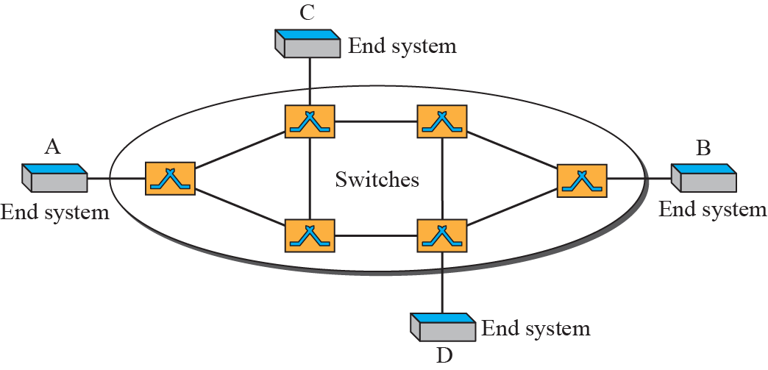
Figure 8.10: Virtual-circuit network
8.<number>
Notes:
8.#
8.#

Slide 37
8.3.2 Virtual-Circuit Networks
A virtual-circuit network uses a series of special temporary addresses known as virtual circuit identifiers (VCI). two types of addressing are involved: global and local.
The VCI at each switch, is used to advance the frame towards its final destination.
8.<number>
Notes:
8.#
8.#

Slide 38
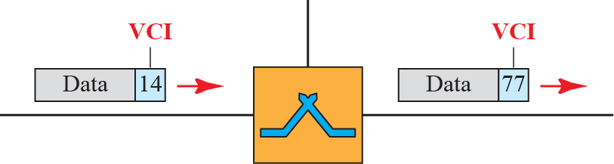
Figure 8.11: Virtual-circuit identifier (compare the VCI to a Datagram destination address)
8.<number>
Notes:
8.#
8.#

Slide 39
8.3.2 Virtual-Circuit Networks
The switch has a table with 4 columns:
a) Inputs half
  Input Port Number
  Input VCI
b) Outputs half
  Output Port Number
  Output VCI
8.<number>
Notes:
8.#
8.#

Slide 40
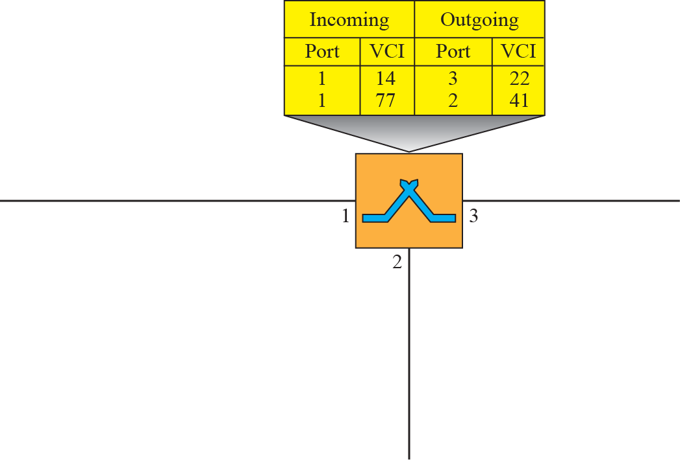



Figure 8.12: Switch and table for a virtual-circuit network
8.<number>
Notes:
8.#
8.#

Slide 41
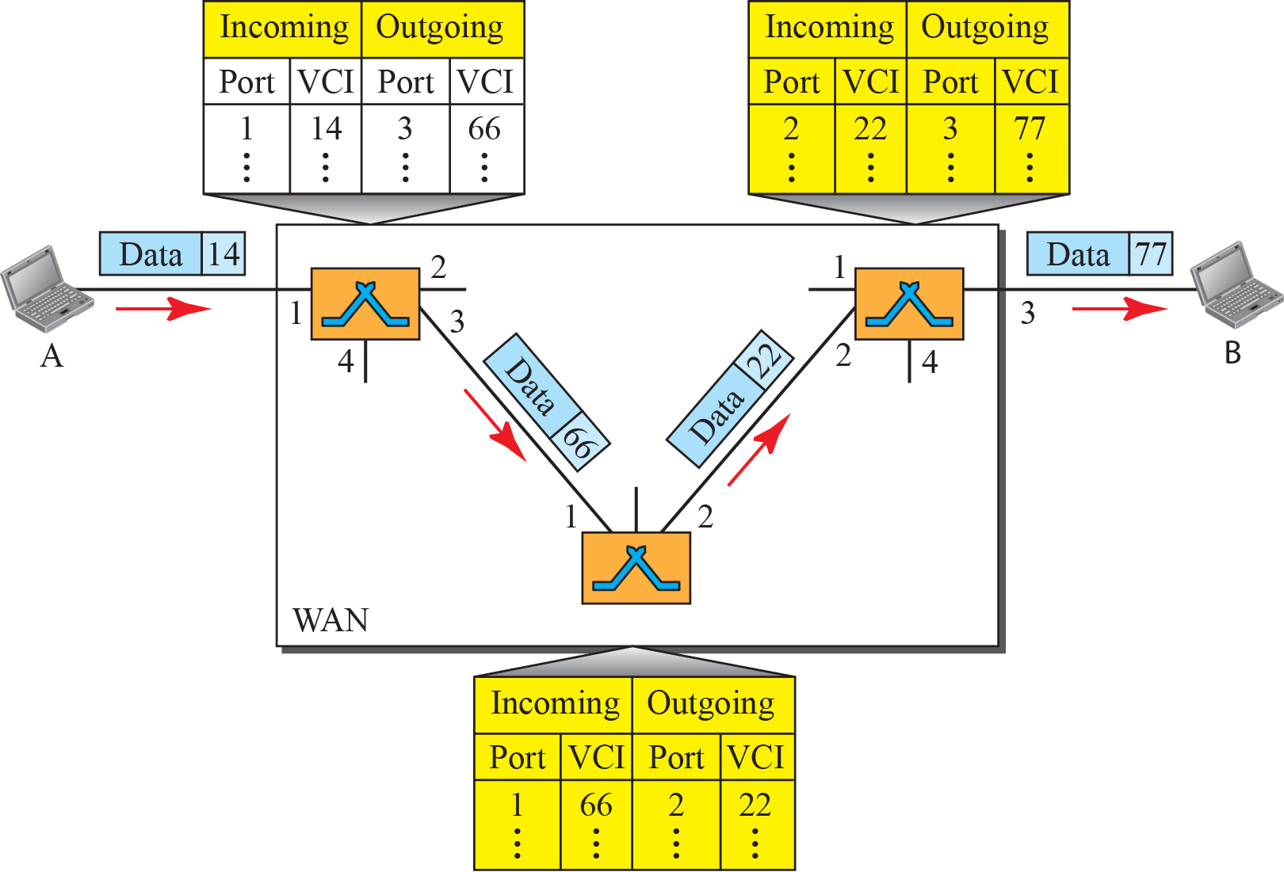
Figure 8.13: Source-to-destination data transfer in a circuit-switch
network
8.<number>
Notes:
8.#
8.#

Slide 42
Virtual Circuit Networks
The VCN behaves like a circuit switched net because there is a setup phase to establish the VCI entries in the switch table.
.
8.<number>
Notes:
8.#
8.#

Slide 43
Virtual Circuit Networks
The VCN behaves like a circuit switched net because there is a setup phase to establish the VCI entries in the switch table.
There is also a data transfer phase and teardown phase.
8.<number>
Notes:
8.#
8.#

Slide 44
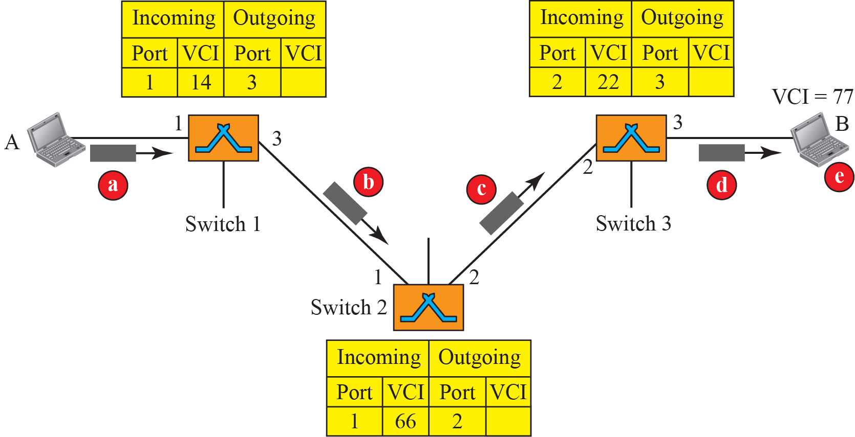
Figure 8.14: Setup request in a virtual-circuit network
All nodes have a VCI
8.<number>
Notes:
8.#
8.#

Slide 45
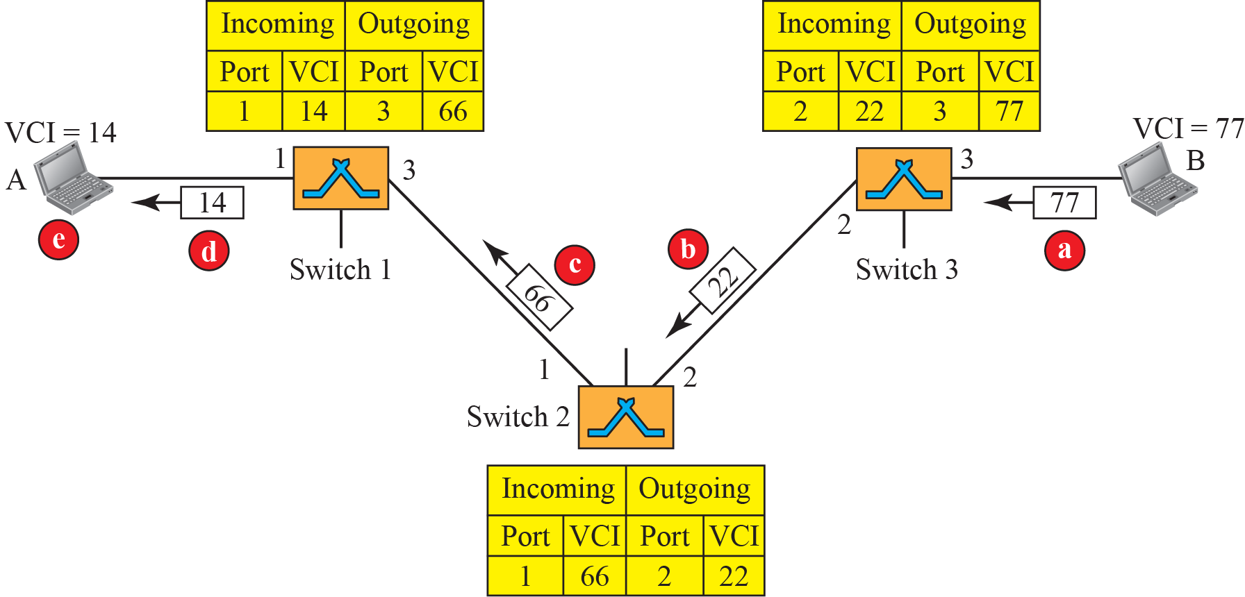
Figure 8.15: Setup acknowledgment in a virtual-circuit network
8.<number>
Notes:
8.#
8.#

Slide 46
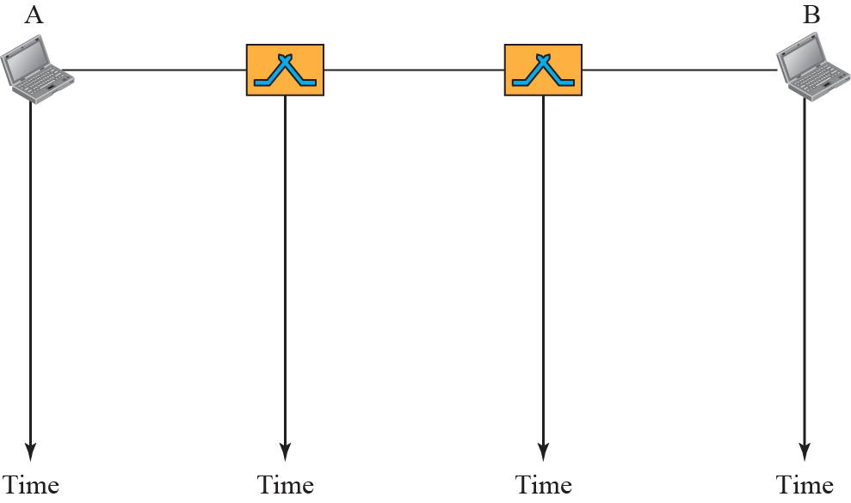


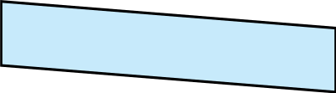

Figure 8.16: Delay in a virtual-circuit network
8.<number>
Notes:
8.#
8.#

Slide 47
    8-4 STRUCTURE OF A SWITCH
This section describes the structure and design of switches used in each type of network.
8.<number>
Notes:
8.#
8.#

Slide 48
    8-4 STRUCTURE OF A SWITCH
The common categories of switch are:
1. Space division
2. Time division
8.<number>
Notes:
8.#
8.#

Slide 49
    8-4 STRUCTURE OF A SWITCH
1. Space division
  Crossbar switch
  Multistage crossbar switch
8.<number>
Notes:
8.#
8.#

Slide 50
    8-4 STRUCTURE OF A SWITCH
Crossbar switch has n inputs m outputs and nxm crosspoints.
8.<number>
Notes:
8.#
8.#

Slide 51
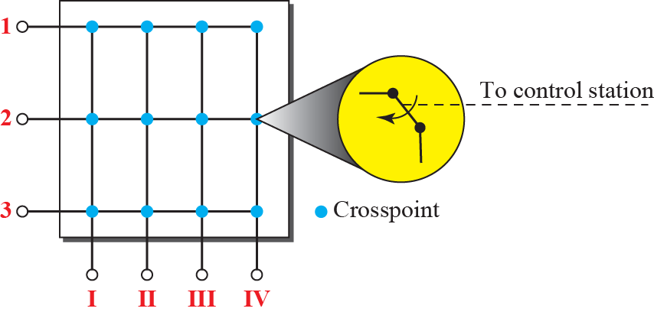
Figure 8.17: Crossbar switch with three inputs and four outputs
8.<number>
Notes:
8.#
8.#

Slide 52
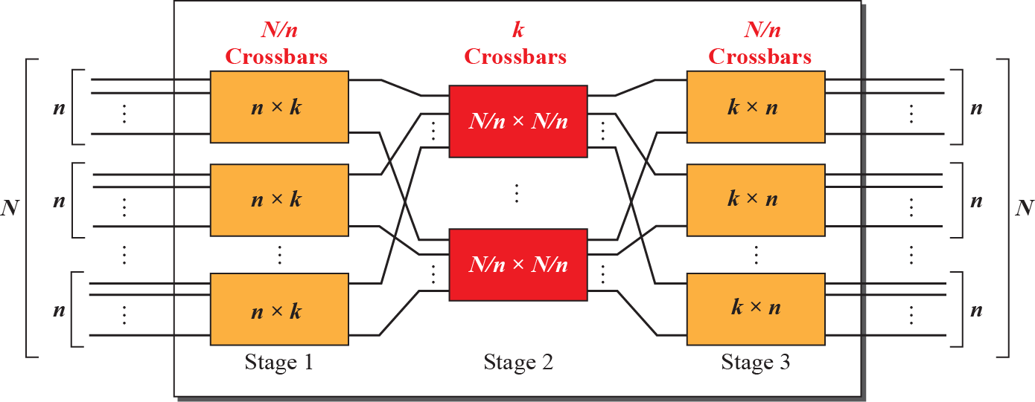
Figure 8.18: Multistage switch
8.<number>
Notes:
8.#
8.#

Slide 53
Example 8.3
Design a three-stage, 200 × 200 switch (N = 200) with k = 4 and n = 20. Compute the number of crosspoints.
8.<number>
Notes:
8.#

Slide 54
Example 8.3
Design a three-stage, 200 × 200 switch (N = 200) with k = 4 and n = 20. Compute the number of crosspoints.
Solution
In the first stage we have N/n or 10 crossbars, each of size 20 × 4. In the second stage, we have 4 crossbars, each of size 10 × 10. In the third stage, we have 10 crossbars, each of size 4 × 20. The total number of crosspoints is
2kN + k(N/n)2, or 2000
crosspoints. This is 5 percent of the number of crosspoints in a single-stage switch (200 × 200 = 40,000).
8.<number>
Notes:
8.#

Slide 55
3 Stage Switch Blocking Factor
Bf3 = (N/n)*k / N = k/n

Slide 56
Example 8.4
Redesign the previous three-stage, 200 × 200 switch, using the Clos criteria with a minimum number of crosspoints.
8.<number>
Notes:
8.#

Slide 57
Clos criteria
n = sqrt(N/2)
k >= 2n – 1
Notes:
8.#

Slide 58
Example 8.4
Redesign the previous three-stage, 200 × 200 switch, using the Clos criteria with a minimum number of crosspoints.
Solution
We let n = (200/2)1/2, or n = 10. We calculate k = 2n – 1 = 19. In the first stage, we have 200/10, or 20, crossbars, each with 10 × 19 crosspoints. In the second stage, we have 19 crossbars, each with 20 × 20 crosspoints. In the third stage, we have 20 crossbars each with 19 × 10 crosspoints. The total number of crosspoints is 2(20(10 × 19)) + 19(20 × 20) = 15200.
8.<number>
Notes:
8.#

Slide 59
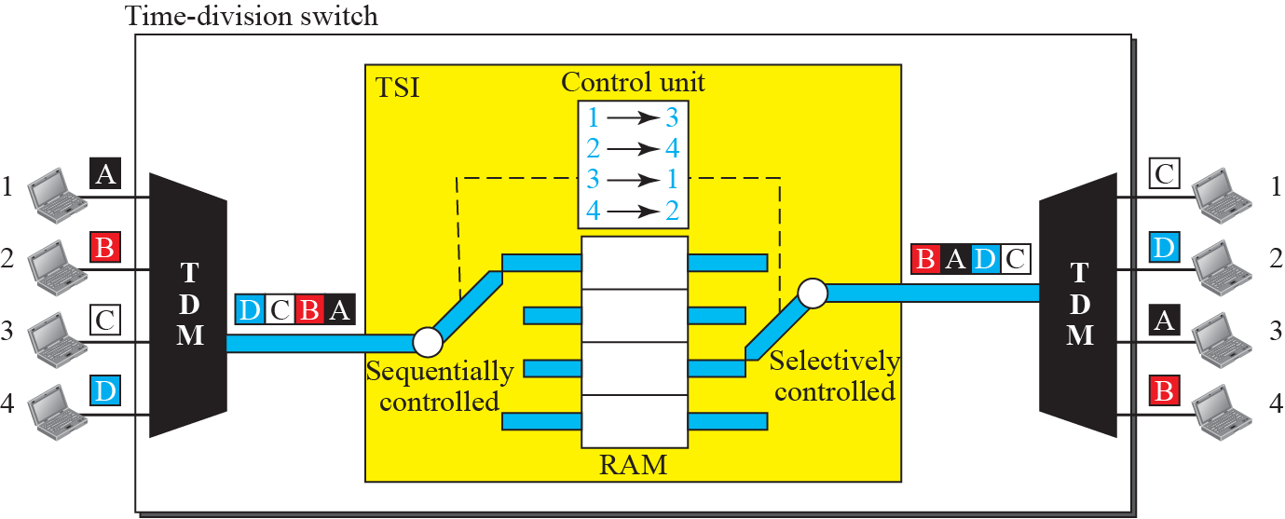
Figure 8.19: Time-slot interchange
8.<number>
Notes:
8.#
8.#

Slide 60
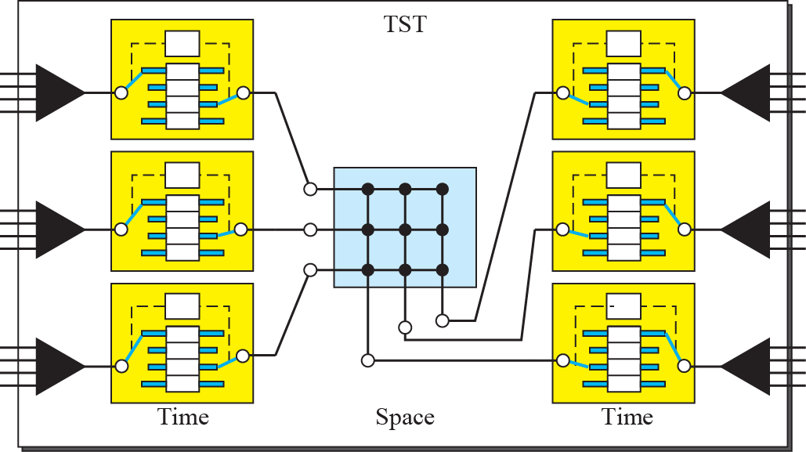
Figure 8.20: Time-space-time switch
8.<number>
Notes:
8.#
8.#

Slide 61
8.4.2 Structure of Packet Switches
Input ports
Output ports
Switching fabric
Routing processor
A switch used in a packet-switched network has a different structure from a switch used in a circuit-switched network. We can say that a packet switch has four components: input ports, output ports, the routing processor, and the switching fabric, as shown in Figure 8.28.
8.<number>
Notes:
8.#

Slide 62
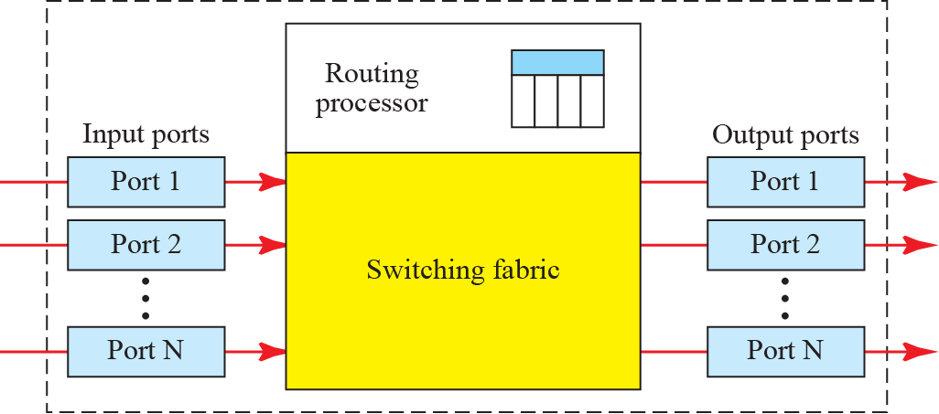
Figure 8.21: Packet switch components
8.<number>
Notes:
8.#

Slide 63
Banyan Switch
n = 2^k ports
log2(n) stages
n/2 binary switches at each stage
number of binary switches = n/2*log2(n)
number of crosspoints = 2*n*log2(n)

Slide 64
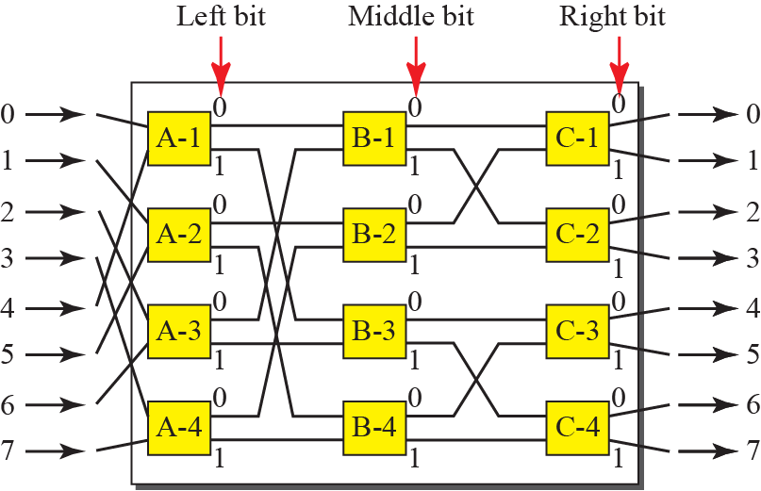
Figure 8.24: A banyan switch
8.<number>
Notes:
8.#

Slide 65
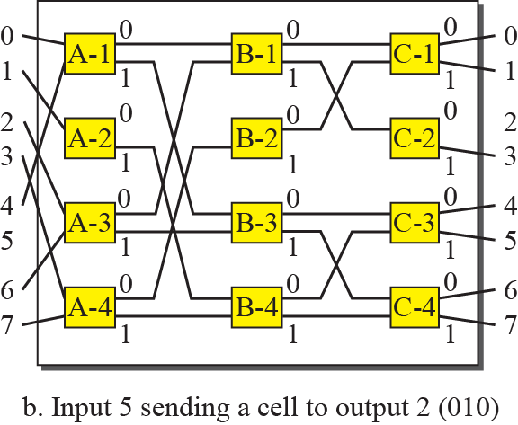

Figure 8.25: Example of routing in a banyan switch (Part b)
8.<number>
Notes:
8.#

Slide 66
Figure 8.25: Example of routing in a banyan switch (Part b)
8.<number>
Notes:
8.#

